Slide 1
Modernizing Content Analytics: Netflix ELT Pipeline
Building a Scalable Star Schema with dbt and BigQuery
Presented by: Team 5

Slide 2
The Business Challenge
Current State: Manual handling of netflix_titles.csv
• Data Integrity: Duplicates in show_id skewing metrics.
• Latency: High manual effort for cleaning and formatting.

Slide 3
Technical Architecture
ELT Framework (Extract, Load, Transform)
• Ingestion: Python/Pandas automation to BigQuery.
• Compute: Google BigQuery as the SQL engine.
• Transformation: dbt for modular SQL modeling.

Slide 4
Star Schema Evolution
Moving from Flat Files to Relational Models
• Staging Layer: stg_netflix handles deduplication.
• Fact Table: 'movies' (Quantitative data).
• Dimensions: 'dim_directors' and 'dim_locations'.

Slide 5
Data Pipeline
Step | File/Command | Outcome
1. Source | netflix_titles.csv | Raw Data
2. Load | python load_to_bigquery.py | Data in raw_source
3. Clean | stg_netflix.sql | No Nulls / No Duplicates
4. Structure | dim_directors.sql | Star Schema Created
5. Validate | dbt test | Data Integrity Confirmed
6. Insight | netflix_analysis.py | Matplotlib Charts Generated

Slide 6
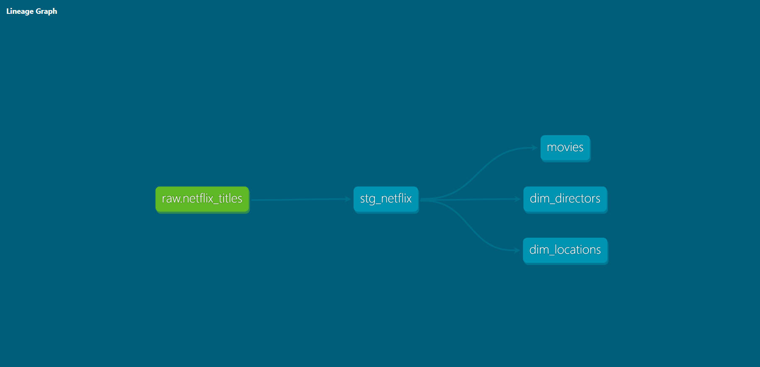
Data Pipeline Lineage

Slide 7
Business Value Proposition
• Operational Efficiency: Automated ingestion reduces manual labor.
• Cost Optimization: Strategic materialization (Views vs. Tables).
• Strategic Insights: Mapping regional growth and talent trends.

Slide 8
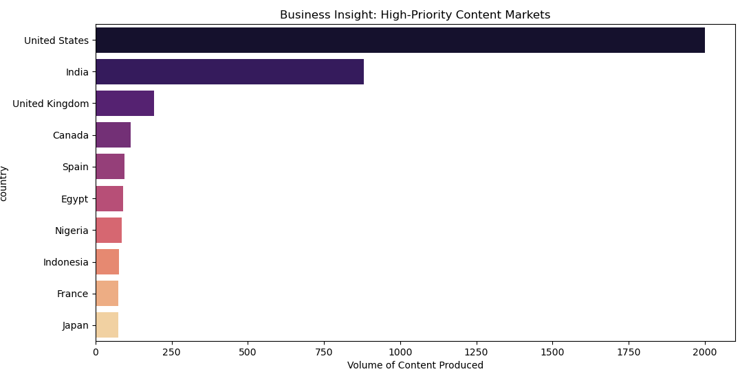
Business Insight 1

Slide 9
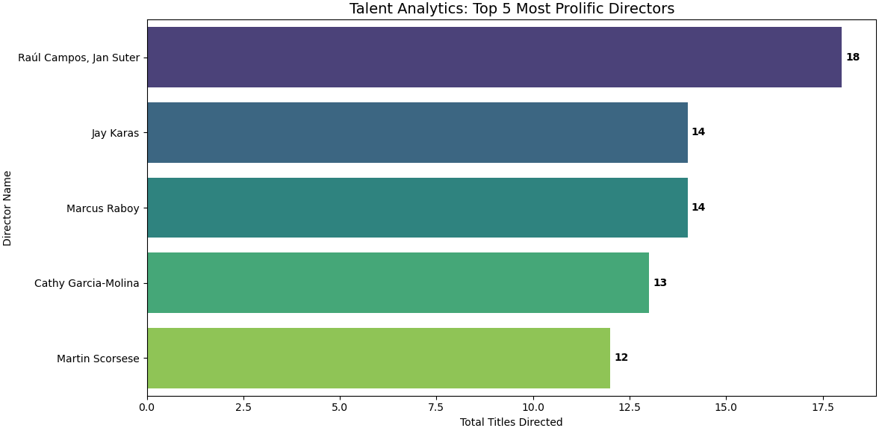
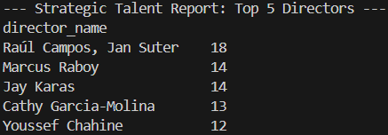
Business Insight 2

Slide 10
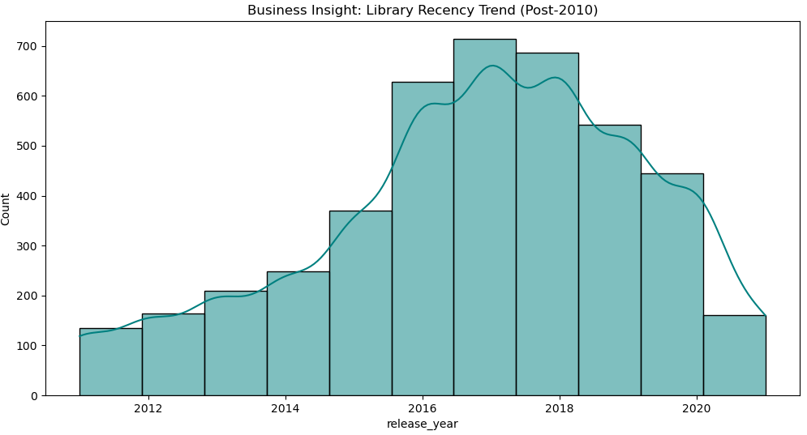
Business Insight 3

